Slide 1
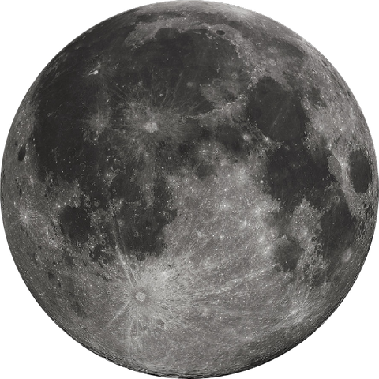



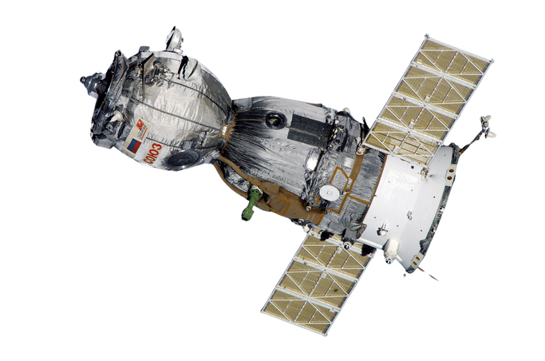
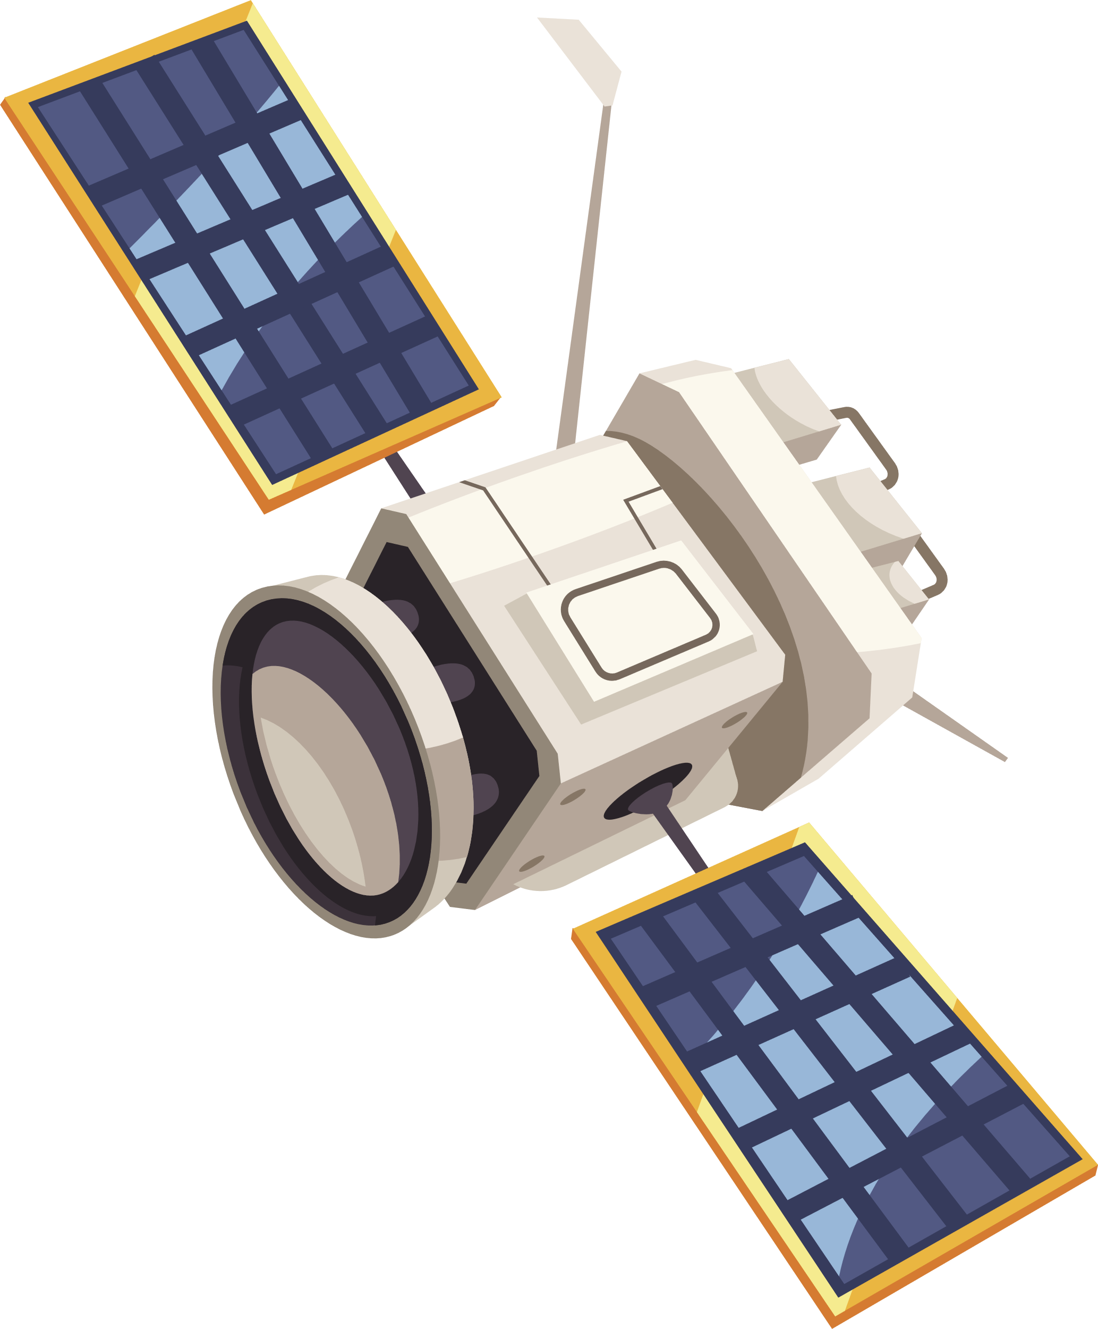
DEVELOPMENT CANSAT
Done by:
Basem Alademi
AbdulWahab Raiz
Mohammed Alhosami
Omar Tarabin Ahmed Aldom

Slide 2




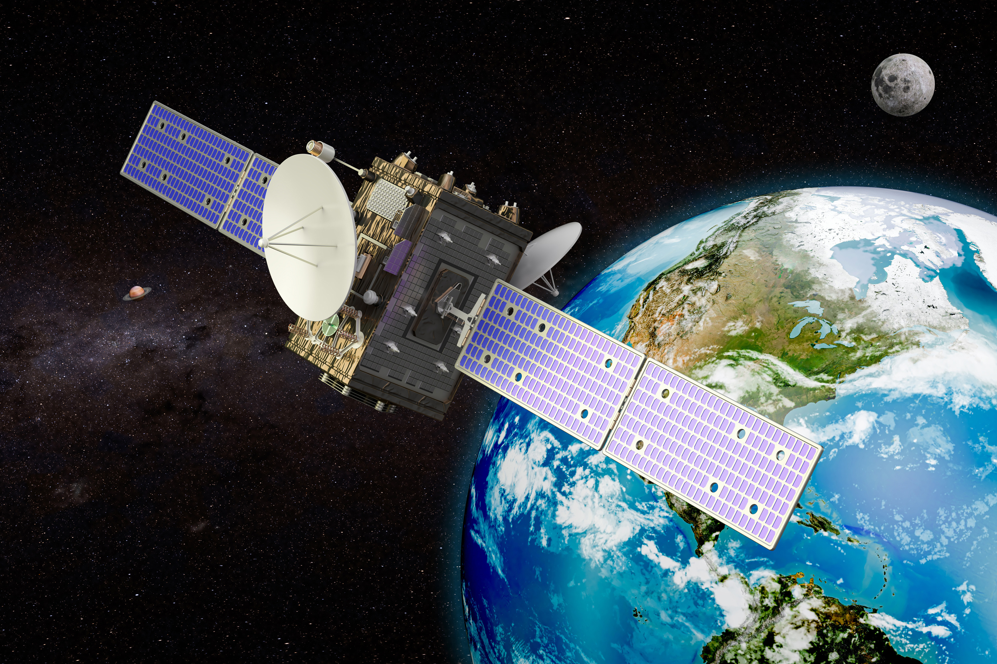


CONTENT
COMMUNICATION & DATA HANDLING (CDH)
01
ABSTRACT
05
02
MISSION STATEMENT
CIRCUIT DIAGRAM AND EXPLANATION
06
GOALS AND OBJECTIVES
03
07
RESULT AND DISCUSSION
04
PAYLOAD DESIGN

Slide 3




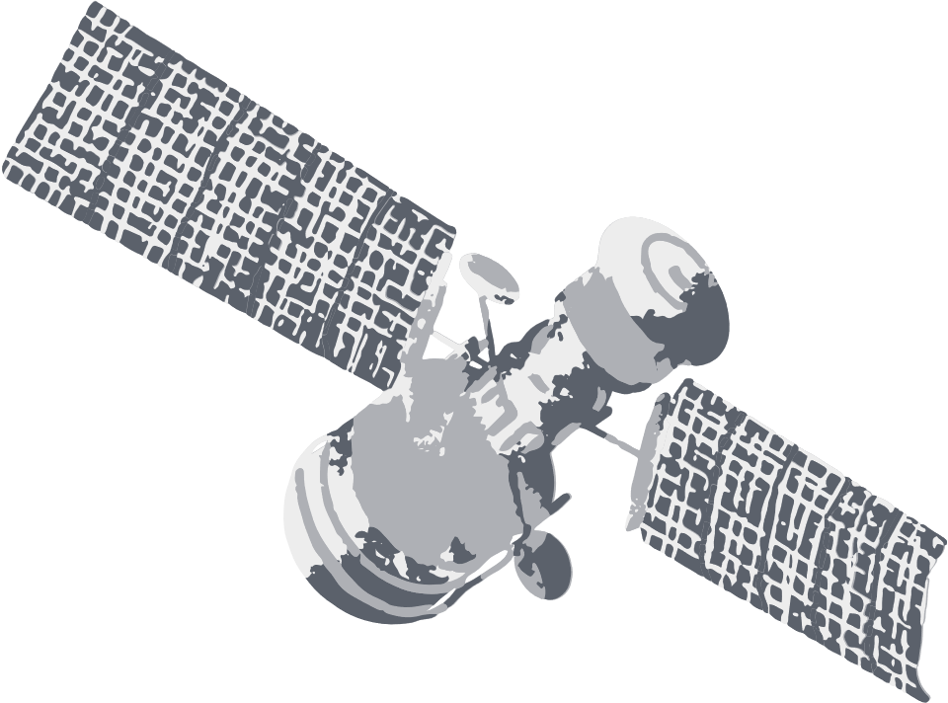

This project focuses on building a low-cost, educational CanSat prototype equipped with sensors and it uses a Arduino Uno for onboard processing and includes a web-based ground station for real-time monitoring. The system simulates real satellite operations, providing a practical learning platform for space technology, embedded systems, and communication.
ABSTRACT

Slide 4
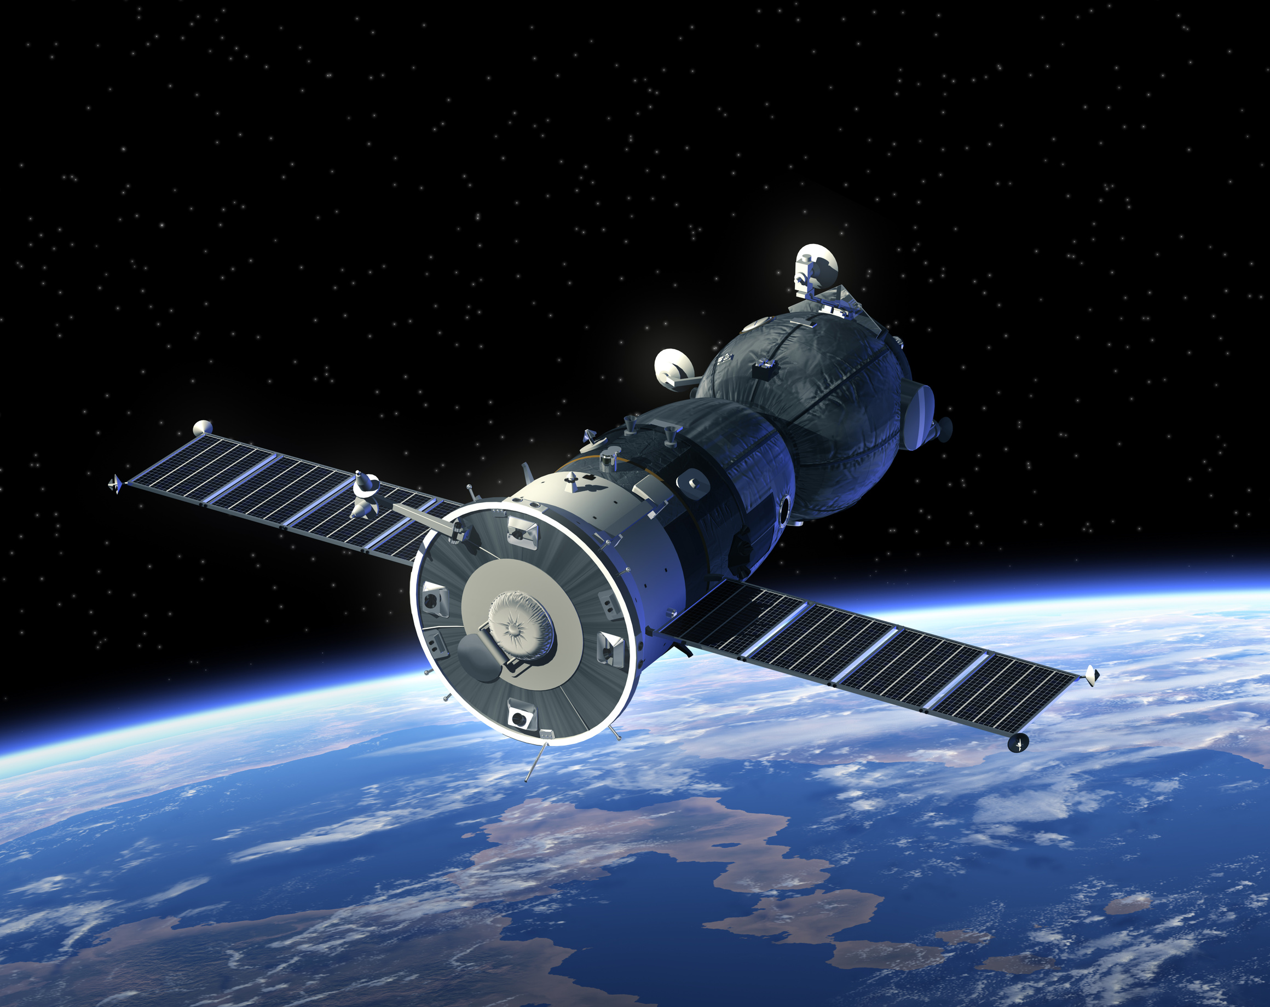

Mission Statement
This project focuses on developing a fully functional canSat equipped with sensors, communication modules, and power management systems for environmental monitoring and data transmission experiments. CubeSats are compact and cost-effective satellites used in scientific research, Earth observation, and technology testing. The project aims to enhance the understanding of space-based sensing and telecommunications, providing a practical platform for testing and validating new satellite technologies.

Slide 5
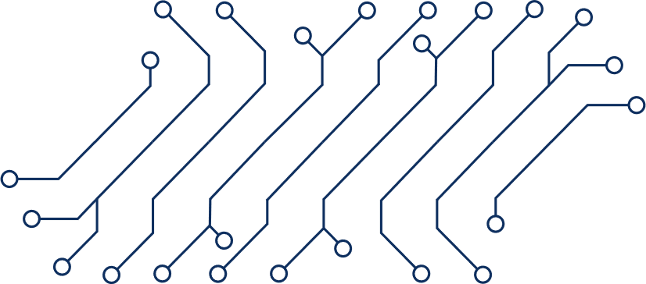
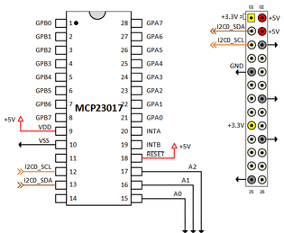
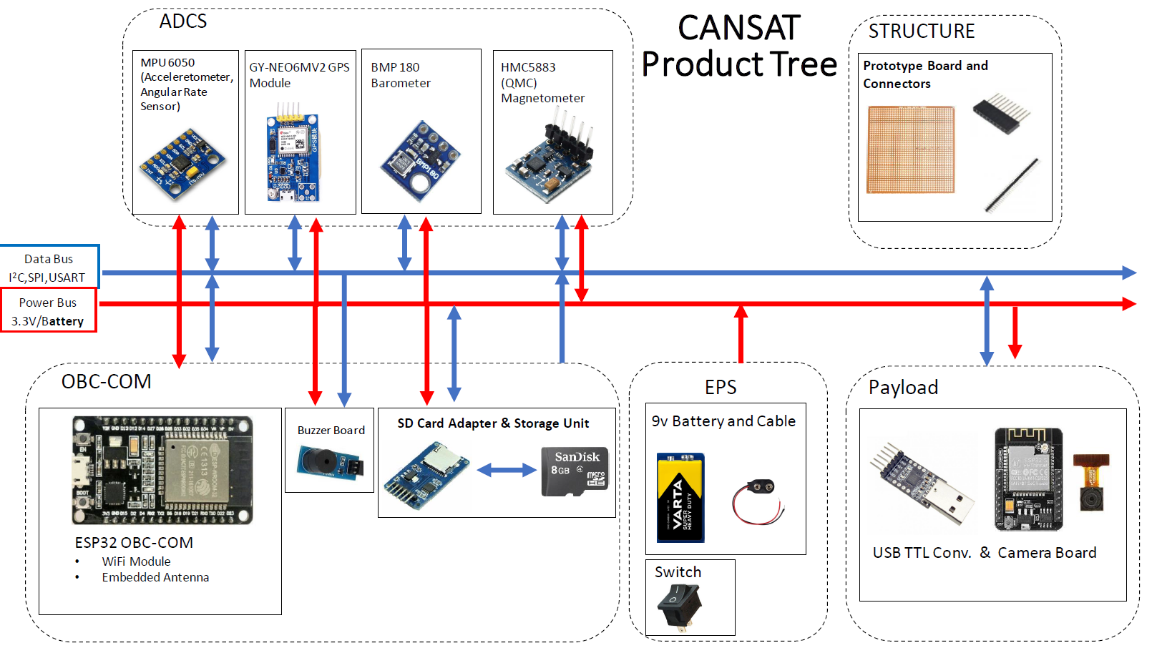

CIRCUIT EXPLANATION

Slide 6




Block Diagram and Explanation
Control Unit (Brain of the Satellite)
Manages all operations, processes sensor data, and communicates with other subsystems.
Electrical Power System (Solar Cells, Batteries)
Supplies power to all satellite components, ensuring continuous operation.
Attitude Determination and Control System (ADCS)
Maintains satellite orientation and stability in space.
Sensors
Collect environmental and system data for monitoring and analysis.
Web Browser
Provides a platform to access real-time data and system status.
Communication System (Antenna)
Transmits and receives data between the CubeSat and the Ground Station.
Ground Station
Receives transmitted data from the CubeSat and sends commands for operations.
Ground Station
ESP32
Web Browser
Electrical Power System
On Board Computer (OBC)
GPS, ANTENNA
batteries
ESP32
Communication system
MPU 9250
BMP 280
Attitude determination and Control System (ADCS).

Slide 7


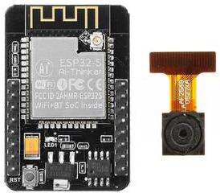

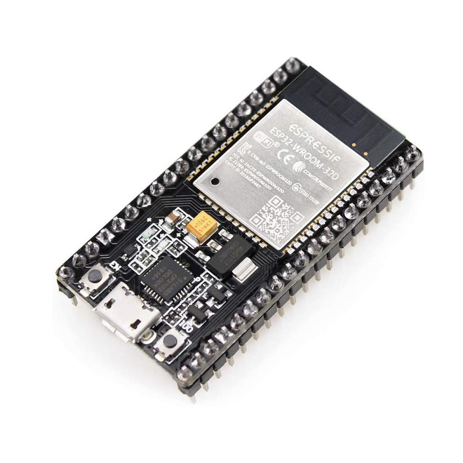

Component Survey
ESP CAM
Interfaces: GPIO, I2C, Wi-Fi.
Collects and processes images from camera and save data.
ESP32
Low-cost microcontroller with built-in Wi-Fi.
Supports communication protocols UART.
It has 34 pins.
Used in the ground station.

Slide 8
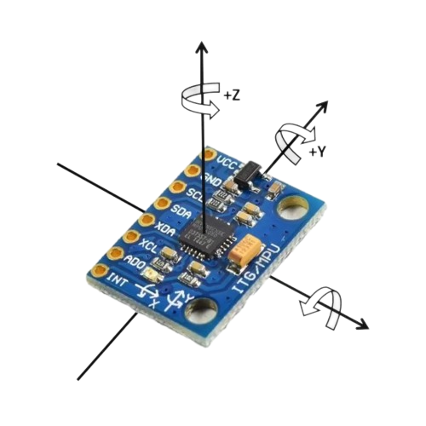

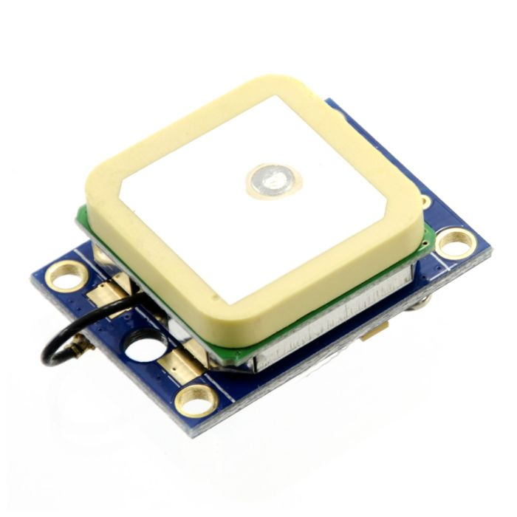
Component Survey
Gyroscope MPU-6050 Sensor
Includes 3-axis gyroscope, 3-axis accelerometer, and 3-axis magnetometer.
Used in attitude determination systems in CubeSats.
Use I2C protocol for communication.
GPS
Provides global positioning data, including latitude, longitude, and altitude, with 5–10 meter accuracy in open sky.
Designed for continuous tracking with low power consumption.

Slide 9
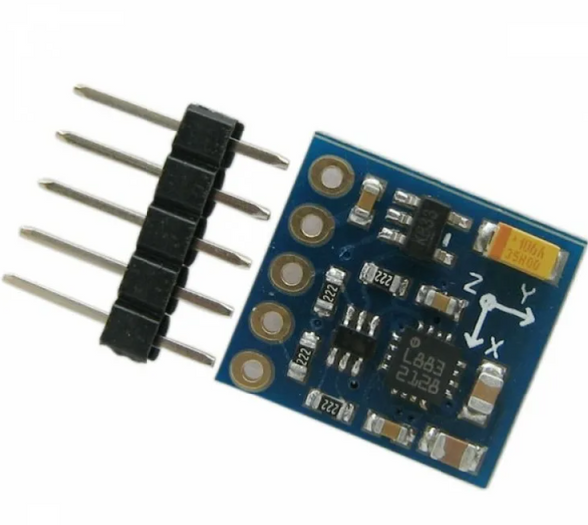

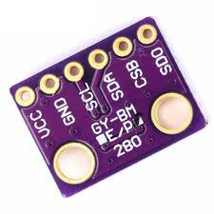
Component Survey
GY-271 Sensor
Measures three-axis magnetic field strength using the HMC5883L chip, with ~1°–2° heading accuracy.
Operates via I²C with low power consumption, suitable for compact, battery-powered devices.
pressure Sensor BMP 180
It is a pressure and temperature sensor.
Pressure range: 300 to 1100 hPa
Temperature range: -40°C to +85°C
It can measure the altitude of the CubeSat from sea level.

Slide 10

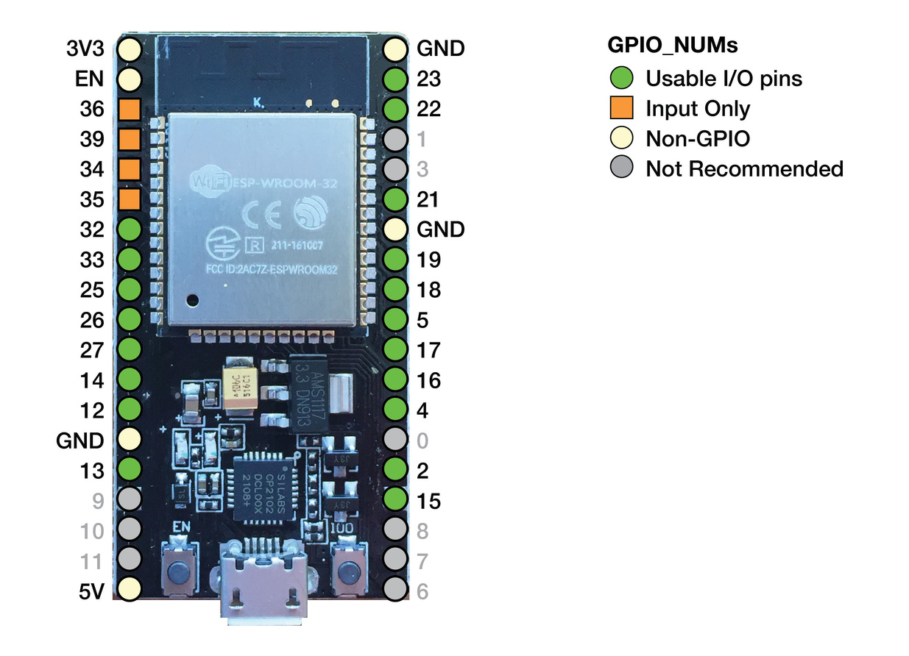
CIRCUIT DIAGRAM
Ground station
Cansat

Slide 11
Tests & Calibrations
📷 Camera Tests – verified image capture quality and storage.
📡 GPS Tests – checked signal reception, positioning accuracy, and update rate.
🎯 MPU Accuracy Tests – validated accelerometer and gyroscope readings against known movements.
🌡️ BMP Accuracy Tests – compared pressure and altitude data with reference instruments.
🔧 Pressure Calibration – applied temperature-based calibration to improve sensor accuracy.

Slide 12
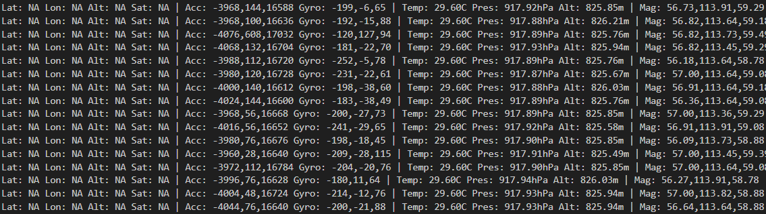
Flight Data

Slide 13
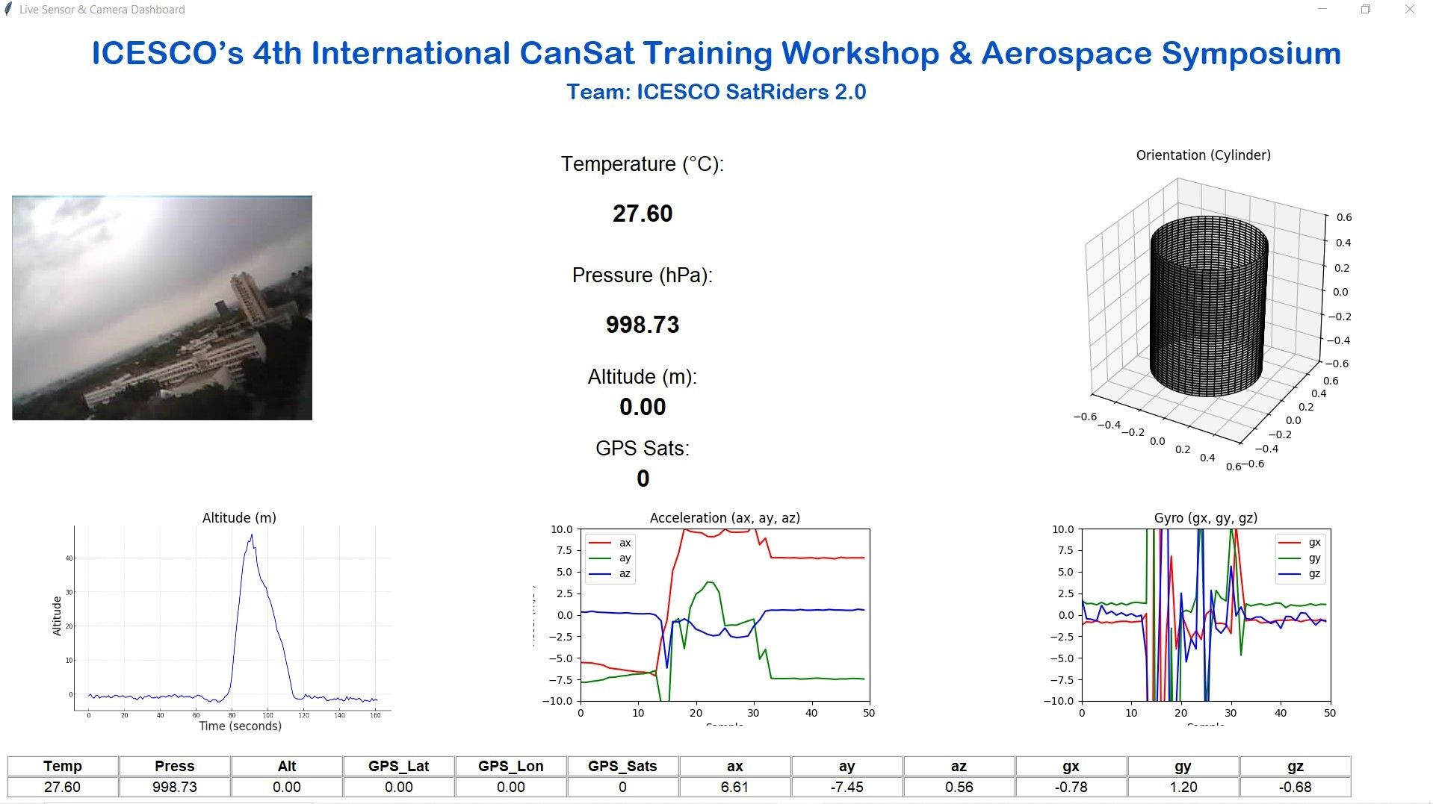


Slide 14
Result and Discussion

Slide 15
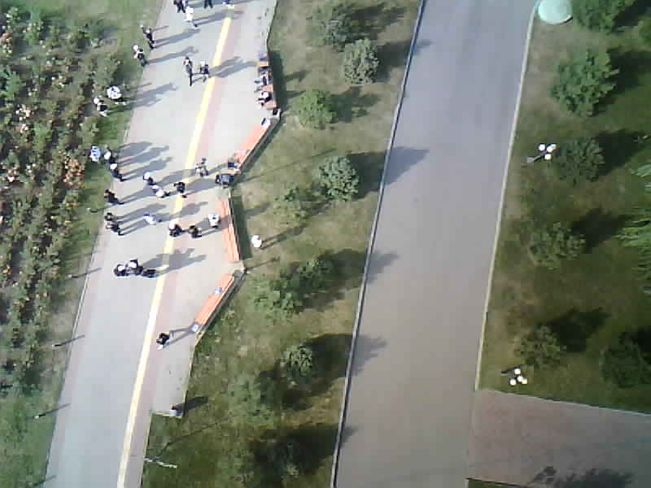
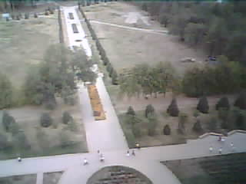
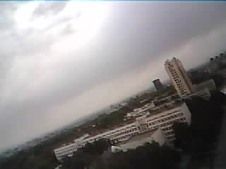
Photos taken by satellite

Slide 16
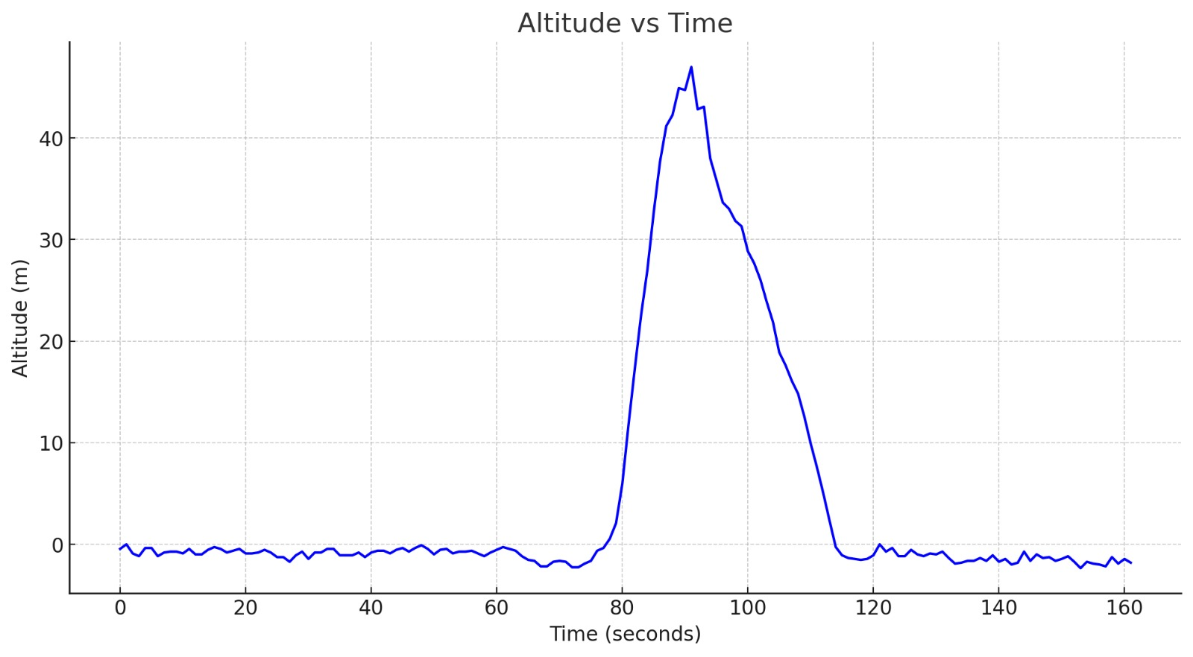
Result and Discussion

Slide 17
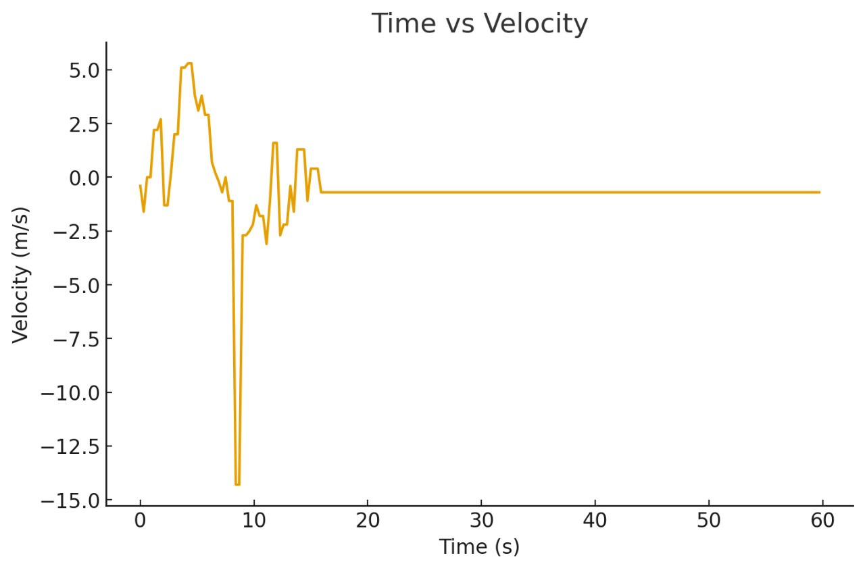
Result and Discussion

Slide 18
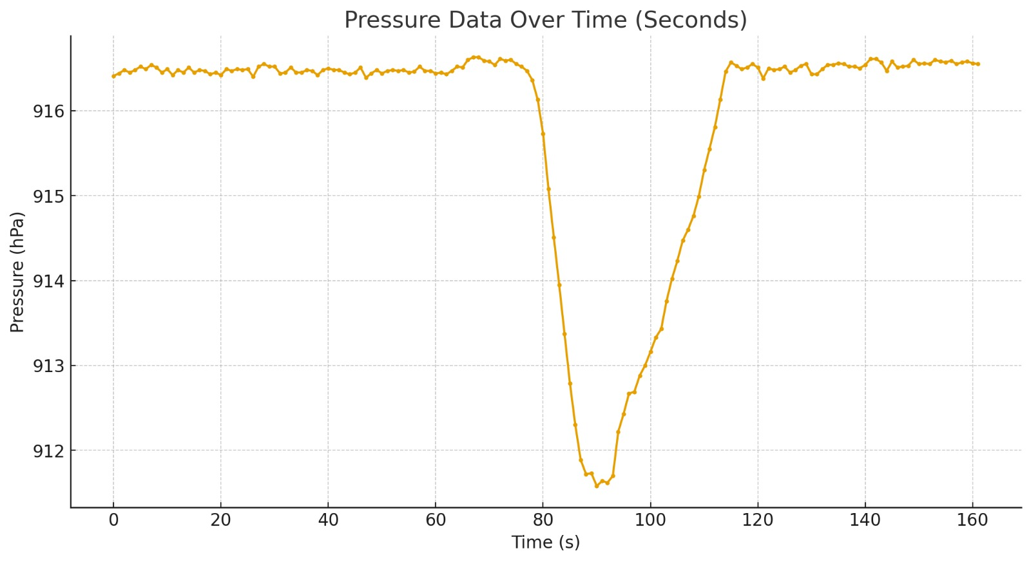
Result and Discussion

Slide 19
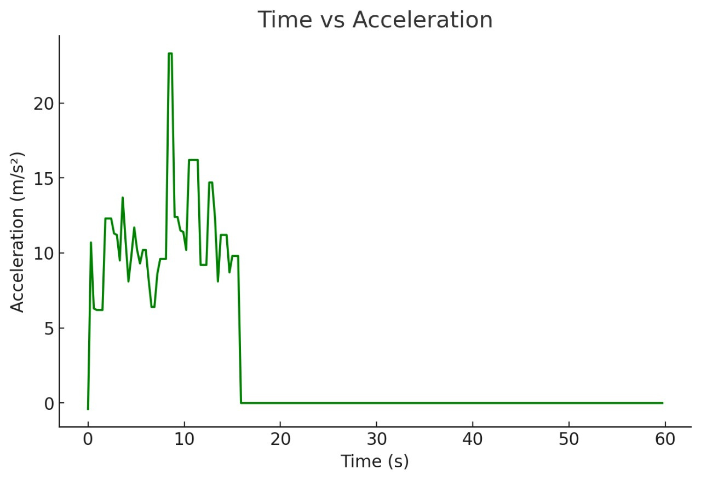
Result and Discussion

Slide 20
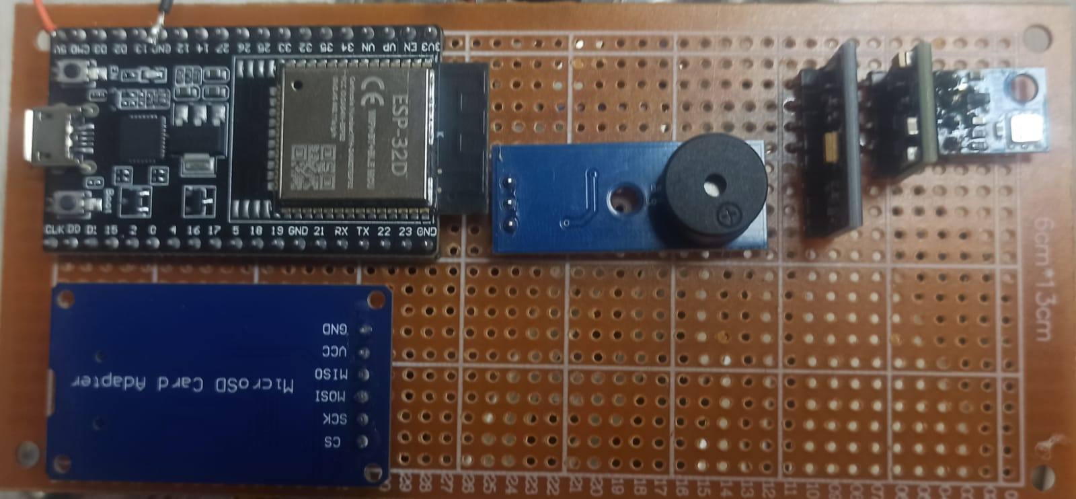
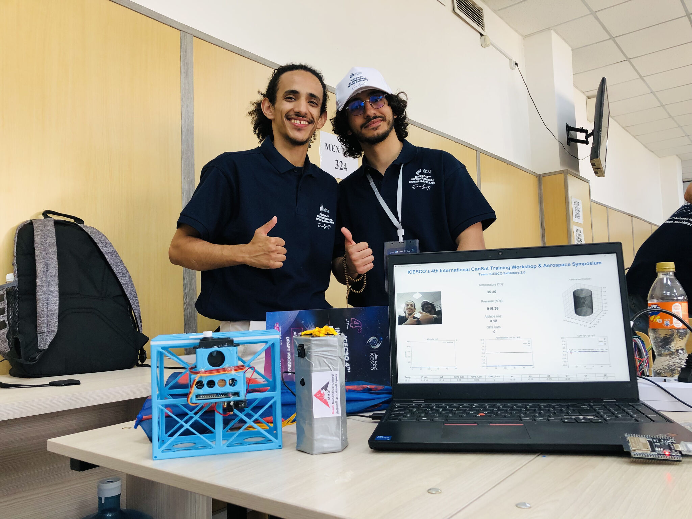
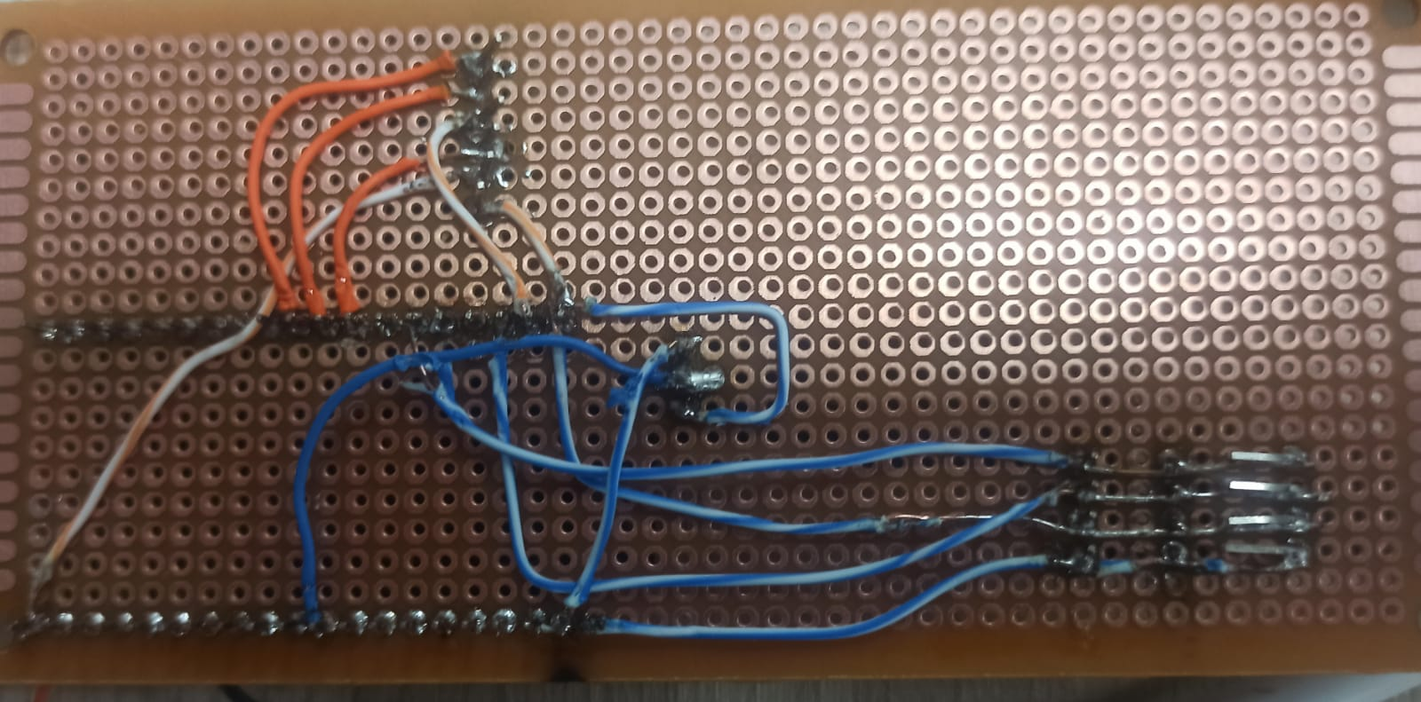
PROJECT PHOTO

